Slide 1

Topic: Statistics & Data
Measure of Spread

Slide 2
Warm up
Gallery Walk:
Resources required: post it notes, A3 paper, coloured textas/pen, blue tac
Ask students to consider the question on next slide and have them consider the answer and jot down a few ideas on a post-it note.
Number students off into groups of 4
Hand out A3 paper one per group. Divide the sheet in 1/3, 2/3 split
Allow time to collabortively discuss the question and present their ideas and In the bottom 2/3rd’s-Have students create a poster of all ideas they can think of related to answering the question.
Pin these posters up around the room.
Allow students to complete a gallery walk viewing others people’s responses.
Finally return to original groups allow time to alter or review the team resonse. Create a final response to the qustion in the top 1/3 of the poster.
Randomly choose someone fromt he group to present this response to the class.

Slide 3
Warm up
A real estate agent tells you that the median house price for a suburb in 2012 was
$753 000 and the mean was $948 000.
Is it possible for the median and the mean to differ by so much?
Under what circumstances could this occur? Discuss.

Slide 4
Key ideas-teaching information
A measure of central tendency (also referred to as measures of centre or central location) is a summary measure that attempts to describe a whole set of data with a single value that represents the middle or centre of its distribution. There are three main measures of central tendency: the mode, the median and the mean. Each of these measures describes a different indication of the typical or central value in the distribution. The mean, median and mode are all valid measures of central tendency, but under different conditions, some measures of central tendency become more appropriate to use than others.
The mean (or average) is the most popular and well known measure of central tendency.
The mean has one main disadvantage: it is particularly susceptible to the influence of outliers.
The median is the middle score for a set of data that has been arranged in order of magnitude. The median is less affected by outliers and skewed data.
The mode is the most frequent score in our data set. You can, therefore, sometimes consider the mode as being the most popular option.
Uselful website
http://www.abs.gov.au/websitedbs/a3121120.nsf/home/statistical+language+-+measures+of+central+tendency

Slide 5
Direct Teaching
Other important information we gain from data is how much the data is spread.
Discuss the difference between the measure of central tendancy and measure of spread.
Why might measure of spread be useful?

Slide 6
Why do we measure spread?
Summarising the dataset can help us understand the data, especially when the dataset is large.
As discussed in the Measures of Central Tendency page, the mode, median, and mean summarise the data into a single value that is typical or representative of all the values in the dataset, but this is only part of the 'picture' that summarises a dataset.
Measures of spread summarise the data in a way that shows how scattered the values are and how much they differ from the mean value.

Slide 7
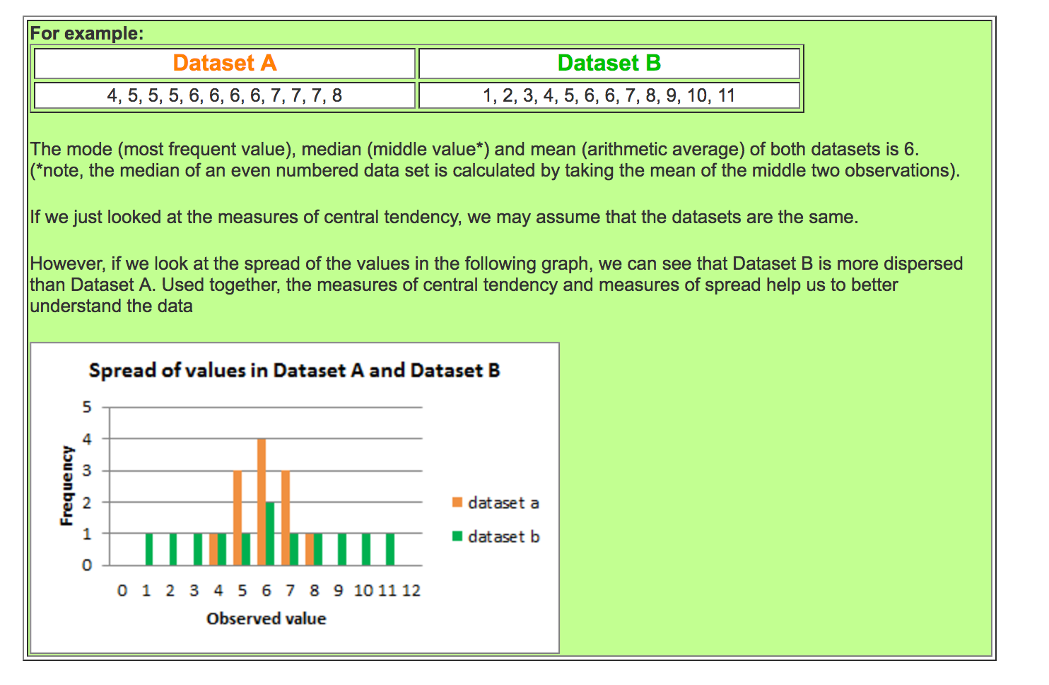

Slide 8
EQ:What are some important measure when looking at data analysis?
Note Taking:
What are measures of spread?
Measures of spread describe how similar or varied the set of observed values are for a particular set of data.
Measures of spread include the range, quartiles and the interquartile range, variance and standard deviation.

Slide 9
When can we measure spread?
The spread of the values can be measured for quantitative data, as the variables are numeric and can be arranged into a logical order with a low end value and a high end value.
What is the Range?
Range is the most common measure of spread.
The range is the difference between the smallest value and the largest value in a dataset.

Slide 10
